Slide 1

REPORT ON DESIGN WORKSHOP
Members: Andrei Agape, Cristian – Dan Cojocaru, Cristina – Ioana Simionescu, David Green, Yoana Zaharieva
Class: DM83
University: UCN Technology & Business, Sofiendalsvej 60, Aalborg 9100
Date: November 9, 2012

Slide 2
Address Book with DVD Loan
Group 2 Workshop Project
Goal of the program
Requirments of the system
Evaluation of group dynamics
Main Menu TUI
Usecases
Design Class Diagrams
Observations of coding
Code standards
Description of tests made
Conclusion

Slide 3
Goal Of The Program
An address book designed to be able to hold information about our friends and a list of DVD's that we are willing to lend out
The system should be designed in a 3 layer Arcitect

Slide 4
Requirements of the system
The address book should be able to hold an ID number
The address book should be able to hold, Name,Address, and Phone Number
You should be able to register DVD's
You should have the ability to modify information and get information about your friends and the DVD's
You should have the ability to lend out DVD's
You should be able to see what person has borrowed which DVD

Slide 5
Evaluation of group Dynamics
Satisfaction of the group process
Generally the group is satisfied with the process. Members managed to cooperate easily and to communicate freely. Everyone was calm and managed to cope with every problem that occurred.
Self evaluation
Members are satisfied with their performance. However, if more time was available, a lot more positive changes to the system could have been made. It is generally accepted that most members gave a lot of themselves to finish the workshop on time.
Communication
Generally the group discussed every step together. Cooperation and communication between the members were good. Everyone managed to fit in a group and to reach their aim at the parts of the project they were supposed to do.

Slide 6
Evaluation of group dynamics
Leaders
It was decided that that the group is not supposed to have a leader. Members worked as a team without formal or informal leader.
Supervision
There was not a project manager of the group. All members took different initiatives in order to contribute to the finishing of the workshop.
Vision of the project
Members believe that if more time was available more changes could have been done. However, the general attitude is positive and team workers are satisfied.
Testing the system
All of the members at some time or another tested the system. If a bug was found, the members that did the programming tried to fix it as soon as possible.

Slide 7
Evaluation of group dynamics
Rules and regulations
All rules and regulations were informal. Members were present and ready for work.
Respect
The atmosphere in the group was good. Members managed to find a good way of cooperation and working as a team.

Slide 8
Requirements of the system
The address book should be able to hold an ID number
The address book should be able to hold, Name,Address, and Phone Number
You should be able to register DVD's
You should have the ability to modify information and get information about your friends and the DVD's
You should have the ability to lend out DVD's
You should be able to see what person has borrowed which DVD

Slide 9
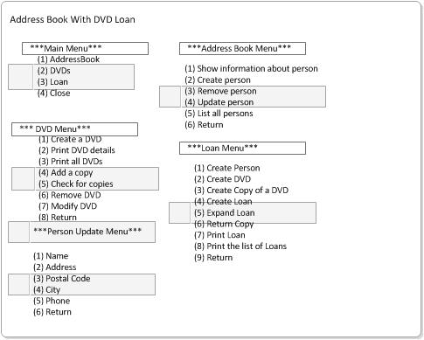
Main Menu TUI

Slide 10
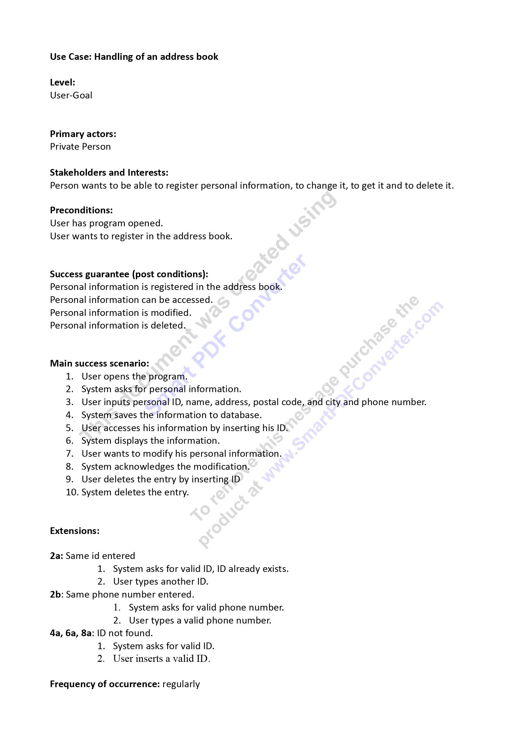
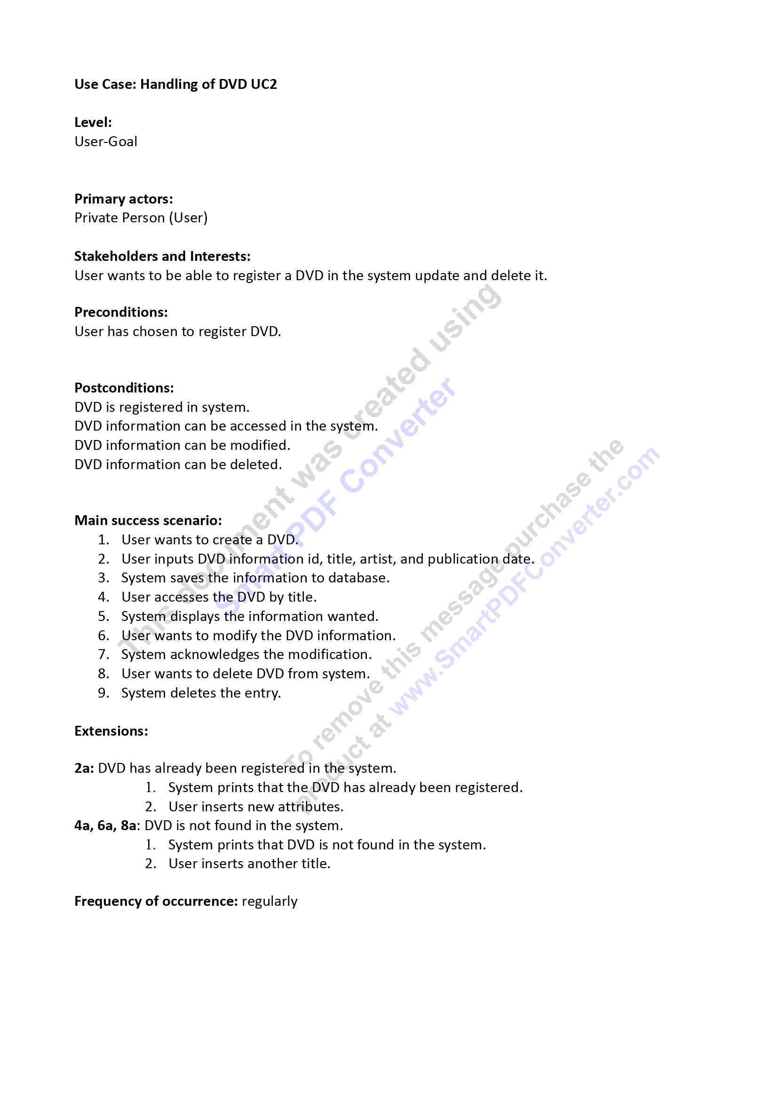
Fully Dressed Use Case

Slide 11
Fully Dressed Use Case

Slide 12
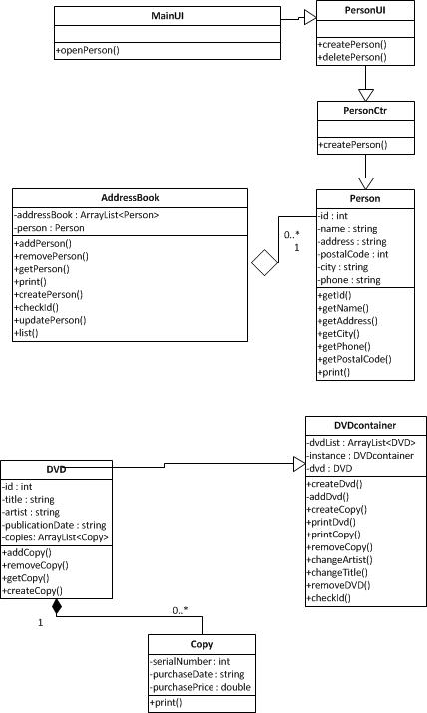
Main Design Class Diagrams

Slide 13
Observations of coding
Our biggest challenge in writing the coding was working as a team because our coders are use to working alone it was a very good practical experience for them.
The next challenge we experienced was in writing the loan class due to the fact that it points to most of the classes and getting it to function the way we wanted it to presented a challenge.
We used an array list to store the information about the users and also the DVD's

Slide 14
Code Standards
When writing the code, the part of the group in charge took into account several rules about naming, layout, documentation and language use.
As for what naming is concerned, they used meaningful names, they used singular nouns class names (which they started with capital letters) and they made sure that the method and variable names started with low-case letters.
For the layout part, they made sure that braces were used in a correct way, blank lines were added between methods and constructors and spaces were placed around operators and before the opening brace of a control structure’s block.
Since documentation is also an important part, the members decided to add comments only when necessary, such as at the top of every class and for every method, while at the same time making them Javadoc-readable.
Last, but not least, they tried to use proper language: the order of declarations was followed, both private and public fields were created, the classes were imported separately and a constructor that initialized all the fields was always added, regardless of the content of the body.

Slide 15
Description of tests made
In order to check whether the source code was running properly and to correct the possible mistakes, the group as a whole ran a few tests that proved to be essential in the process.
- Test 1: One of the tests performed involved trying to add a person to the address book by inserting an ID that already existed, knowing that this should return an error (negative testing). As expected, the message ‘ID already exists.’ was printed.
- Test 2: Another test included adding DVDs to the DVDcontainer class and then printing a list of all DVDs to check if the correct information is printed (positive testing). Consequently, all DVDs that had been added were printed.

Slide 16
Conclusion
To summarize the work we did was in a cooperative approach we had no group leader and just split all of the work in half to be completed.
If we had more time we would have done the reports first then started the coding but due to time constraints we had to begin coding from the start of the project

